Slide 1
Building a 3-bit Flash Analog to Digital converter
Instructed By
Dr. Shabbir Ahmed
Dr. Md. Rezaul Karim
Group: B03
Md. Abu Horaira(26)
Shraban Karmoker Avi(44)
Md. Adib Ahsan(60)

Slide 2
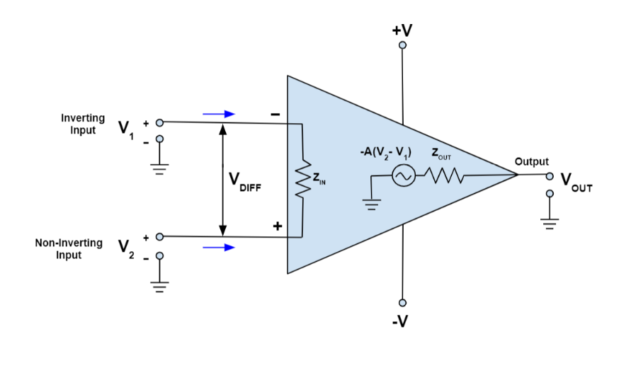
Op-Amp
Op-Amp is a amplifier with high gain and stability.
Can perform mathematical operations .
Consists of two input (inverting , non-inverting), one amplified output and two voltage supply(+v, -v) where the op-amp works.

Slide 3
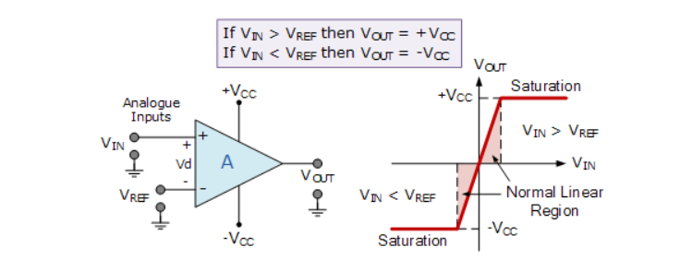
Comparator (Op-Amp)
Comparators are a type of circuits which compares two voltages and outputs either a 1 or 0 to indicate which is larger.
If voltage on the non-inverting input is higher, the output will create a positive voltage that amplifies the difference in input voltages.

Slide 4
Priority Encoder
INPUT
OUTPUT
D0 | D1 | D2 | D3 | D4 | D5 | D6 | D7 | Y1 | Y2 | Y3
1 | 0 | 0 | 0 | 0 | 0 | 0 | 0 | 0 | 0 | 0
X | 1 | 0 | 0 | 0 | 0 | 0 | 0 | 0 | 0 | 1
X | X | 1 | 0 | 0 | 0 | 0 | 0 | 0 | 1 | 0
X | X | X | 1 | 0 | 0 | 0 | 0 | 0 | 1 | 1
X | X | X | X | 1 | 0 | 0 | 0 | 1 | 0 | 0
X | X | X | X | X | 1 | 0 | 0 | 1 | 0 | 1
X | X | X | X | X | X | 1 | 0 | 1 | 1 | 0
X | X | X | X | X | X | X | X | 1 | 1 | 1
Priority encoder contains 2^n input lines and n output lines.
When multiple input lines are active high at the same time, then the input that has the highest priority is considered first to generate the output.
X indicates input will not have any effect on output

Slide 5
Project circuit and Flash ADC
Flash ADC is formed of a series of comparators, each one comparing the input signal to a unique reference voltage.
Comparator outputs are connect to the inputs of a priority encoder circuit, which produces a binary output.
Steps:
Setting Reference Voltages
Setting and Comparing input Voltage
Priority Encoding
LED Display

Slide 6
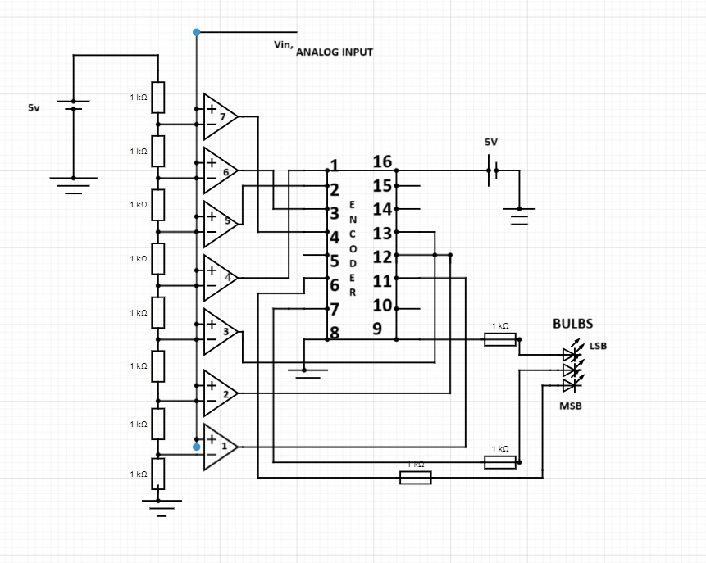
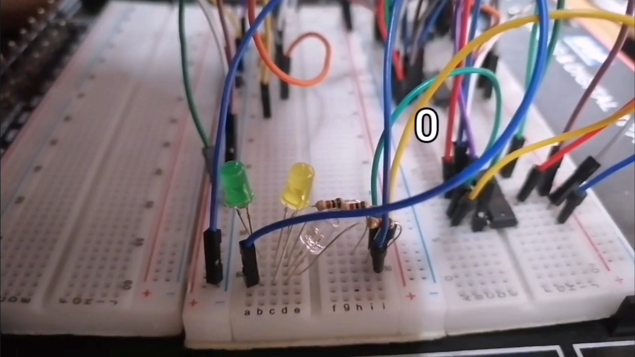
Project circuit and Flash ADC

Slide 7
Input voltage range for digital bits
Input voltage range (V) | Binary Output
0-0.625 | 000
0.625-1.25 | 001
1.25-1.875 | 010
1.875-2.5 | 011
2.5-3.125 | 100
3.125-3.75 | 101
3.75-4.375 | 110
4.375-5 | 111

Slide 8
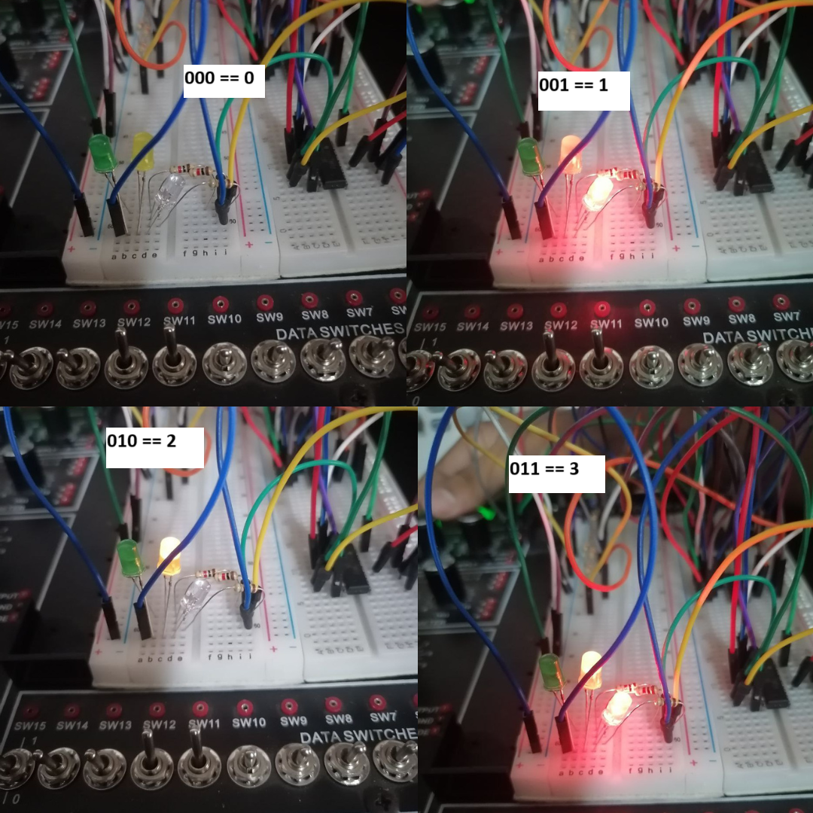
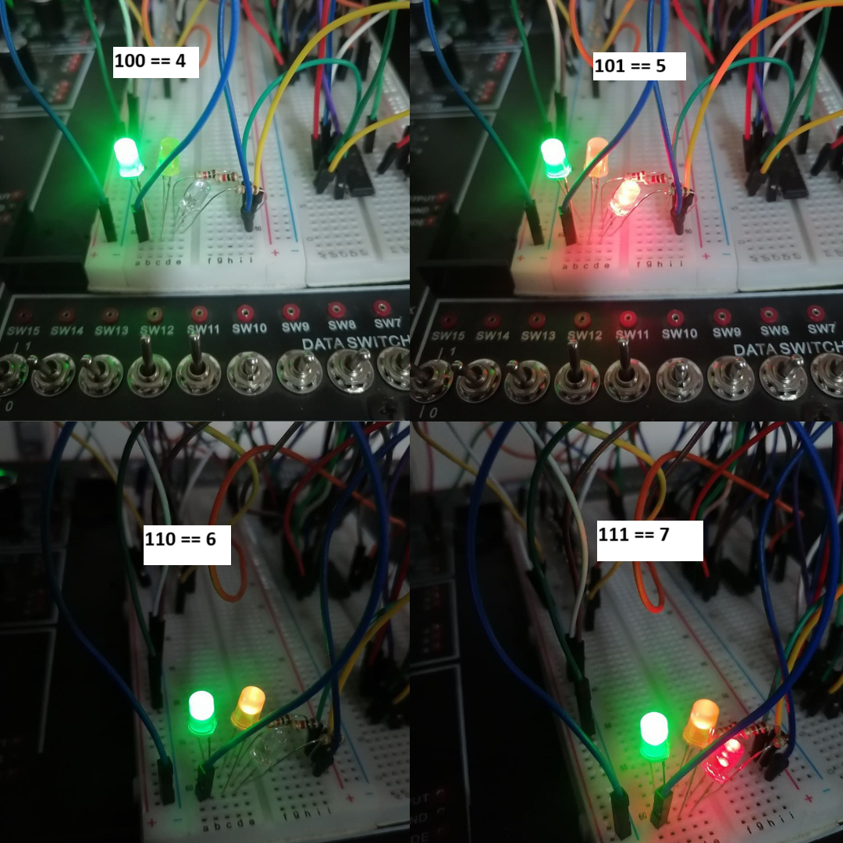
project pictures

Slide 9
Summary
Thank you

